Slide 1
niceride Ridership Trends and COVID-19 Impacts
Rachel Fizel, Luis Gomez, Brandon Overlie, Stephanie Richards

Slide 2
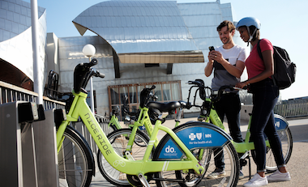
What is niceride?
“Bikeshare” service
Started in 2010
Season starts in April, ends in November
400+ stations across Minneapolis
Riders can pay per Single Ride, Day Pass, or Annual Membership

Slide 3
Our Hypotheses
Steadily increasing ridership from 2015 – 2019
Expect a sharp decrease in ridership in 2020 due to the COVID-19 pandemic
For 2020, we should see ridership fluctuate with new restrictions and protests
When restrictions are loosened, we should see increased rides
When restrictions are reinstituted, we should see decreased rides
Expect ridership disruption following the death of George Floyd
Weather has an impact on ridership
Expect warmer weather to result in increased rides
For 2020, we expect to see fewer rides from downtown and the University than in previous years

Slide 4
Research Questions
Did the COVID-19 pandemic affect niceride usage in 2020?
How does the number of rides change from month to month each year?
Did the pandemic affect patterns of ridership (i.e. Member vs. Casual riders, Weekday vs. Weekend rides)?
Can we find a correlation between COVID restriction dates, and number rides?
What was the impact of protests and riots after George Floyd’s death on ridership?
How does weather impact the data?
Can we see changes in geographic ridership patterns in 2018, 2019 and 2020?

Slide 5
Resources used
niceride system data (https://www.niceridemn.com/system-data)
NOAA MSP Airport Weather data (https://www.ncdc.noaa.gov/cdo-web/)
Executive orders from the governor of Minnesota (https://mn.gov/governor/news/executiveorders.jsp)
Google Maps API (https://developers.google.com/maps)

Slide 6
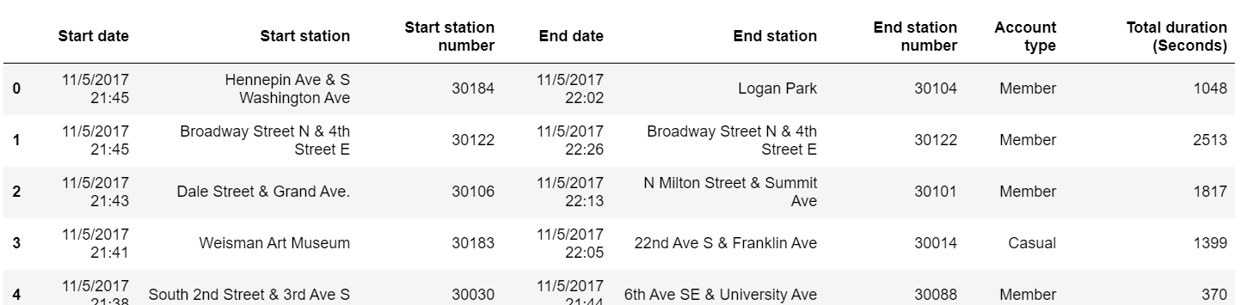
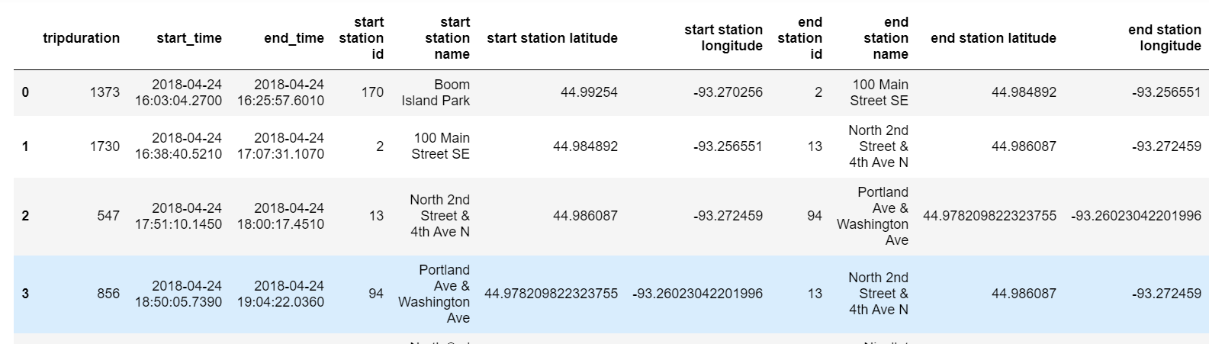
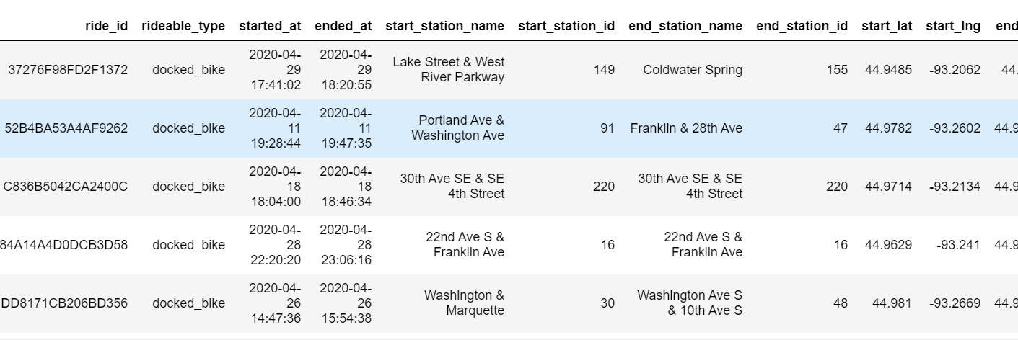
Data challenges and limitations
Docked vs. Dockless Bikes
3 different data formats
NA’s and garbage data
2 missing data points in 2020
Different season lengths
2015-2017
2018-2019
2020

Slide 7
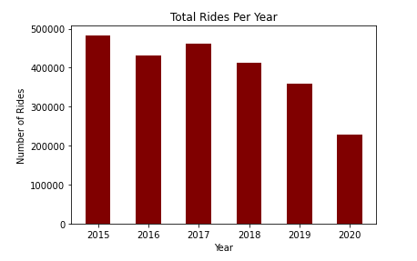
Total ridership per year

Slide 8
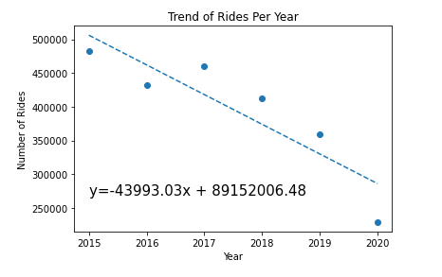
Projected 2020 Ridership vs. Linear Trend

Slide 9
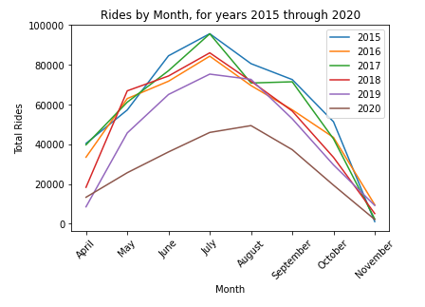
Monthly Ridership for years 2015 through 2020 (line graphs)
Notes:
Reaffirms downward trend
2015 was the most prolific year for niceride
Normal distribution
Peaks in 2015-2019: July, 2020: August

Slide 10
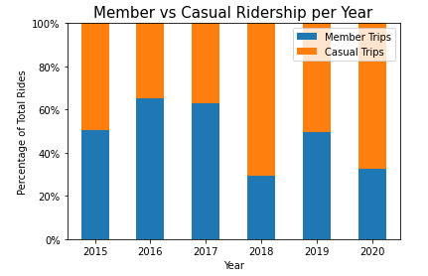
Casual vs. Membership Trends for 2015 through 2020 (stacked bar chart)
Notes:
Membership trips: 50-60% (2015-2017)
Drop after 2018
2020 was 2nd worst year

Slide 11
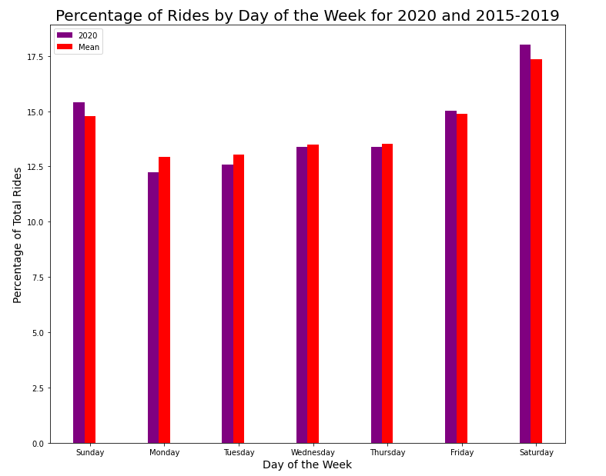
Ridership by Day of the Week from 2015 through 2020
Notes:
2020 vs mean 2015-2019
Weekday trips down, weekend trips up
In combination with member vs. casual suggests more leisure than commuting

Slide 12
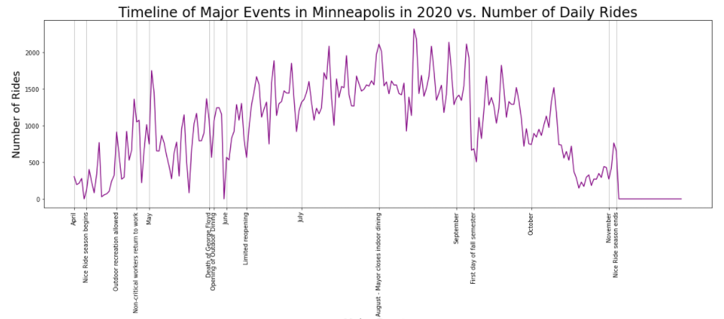
2020 Daily Ridership vs. Timeline of Major Events

Slide 13
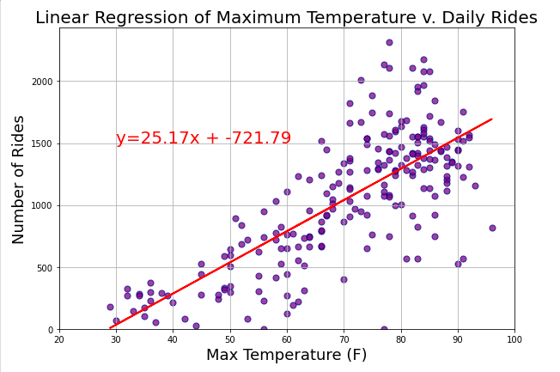
Weather effects on 2020 Ridership

Slide 14
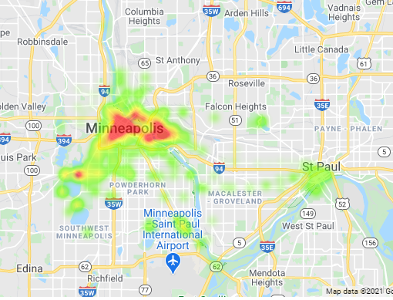
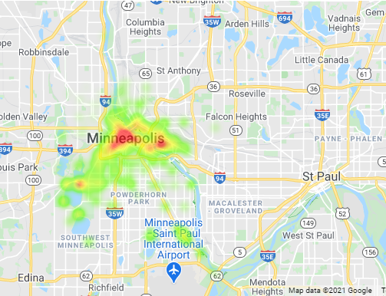
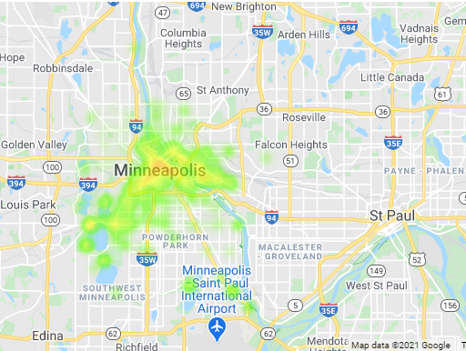
Geographical Ride Trends
2018
2019
2020

Slide 15
Conclusions
COVID-19 had a significant negative impact on niceride usage
This is reaffirmed by our heat map
year over year decline in ridership went against our expectations which can be attributed to the introduction of dockless scooter sharing in 2018
Our 2020 timeline of COVID restrictions and protests did not show an immediate effect on ridership
Daily rides, when compared against daily high temperatures, show a strong positive correlation
2020 shows an increased share of casual and weekend rides, which suggests people were using niceride more for leisure than for commuting

Slide 16
Questions?

